Slide 1
Real-time video stitching

Slide 2
Idea behind the concept...
The system uses two MIPI cameras to capture video frames for real-time stitching.
The stitched view will be panoramic.

Slide 3
Hardware specifications
Two AR0234 global shutter mipi cameras
Jetson nano
During algorithm-development phase:
X86 Machine & logitech webcameras C920 & C922

Slide 4
Video Stitching work-flow
Video frames capture
Feature points detection
Camera matrix calc.
Bundle Adjustment
Mask creation and seam finder init.
Warper selection
Exposure compensator init.
Image warping
Blending

Slide 5
Video-frames capture
Input frames captured are in BayerGR 10-bit format. Conversion steps required are as follows:
10-bit to 8-bit conversion, BayerGR to BGR color format conversion.
Optional: Crop frames vertically as per the view preference.
Note: White balancing required to remove greenish effect from the fetched frames from the camera

Slide 6
Feature detection & matching
Feature detector used is ORB - Oriented FAST and Rotated BRIEF
Detects & matches keypoints in overlapping areas
Initialization of the finder object finder = ORB::create();
computeImageFeatures(finder, img, features[i]); Detects and stores keypoints and descriptors from each frame, enabling reliable feature matching for homography estimation.

Slide 7
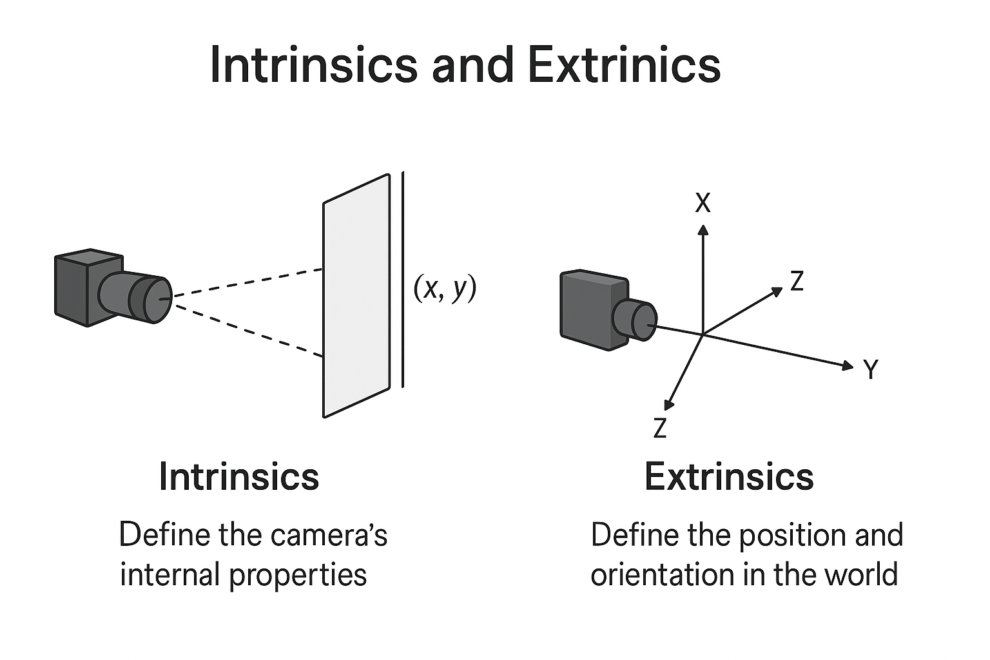
Camera Matrix Estimation
Used to estimate camera parameters (intrinsics and extrinsics) between overlapping frames.
Computes homography matrices using matched feature points from adjacent images.
Derives the camera matrix (K) and rotation (R) for each frame.
Intrinsics define the camera’s internal properties (focal length, principal point), while extrinsics define its position and orientation in the scene.

Slide 8
Bundle Adjustment
adjuster = makePtr<BundleAdjusterRay>(); provides refined camera matrices used for accurate warping and blending.
Refines camera parameters (rotation, translation, focal length) estimated from the homography stage.
Minimizes reprojection error between observed and predicted feature points.
Ensures global consistency of camera poses across all frames.

Slide 9
Mask creation, Seam finder initialization & Exposure compensation initialization.
Mask creation is required to guide seam finding and ensure only meaningful pixel regions contribute to blending.
Seam finding is required in reduction of visible discontinuities caused by parallax or misalignment.
We use GraphCutSeamFinder seam finder in our algorithm minimize intensity differences across seams.
Exposure compensator compensate global or local intensity differences due to lighting or auto-exposure settings.
Implemented using GainCompensator in opencv, ensures uniform exposure across final panorama.

Slide 10
Image/frames Warping
Warping is the step that geometrically aligns all video frames to a common reference so that stitching can happen without visible misalignments.
cv::detail::SphericalWarper(); Sets up a projection model that maps each image onto a virtual sphere, minimizing perspective distortion.
Spherical warping reprojects each image as if it were captured on a common sphere centered at the camera’s nodal point.
This transformation corrects for perspective mismatches, keeps straight lines natural, and ensures smooth transitions between overlapping images.

Slide 11
Blending
A default blender object is created using Blender::createDefault(blend_type, try_cuda) to combine overlapping image regions smoothly.
MultiBandBlender is used to blend images at multiple frequency bands, minimizing visible seams and exposure differences.
blender->blend(): Combines all warped and exposure-compensated images into a single seamless panorama by smoothly merging overlapping regions and minimizing visible seams.

Slide 12
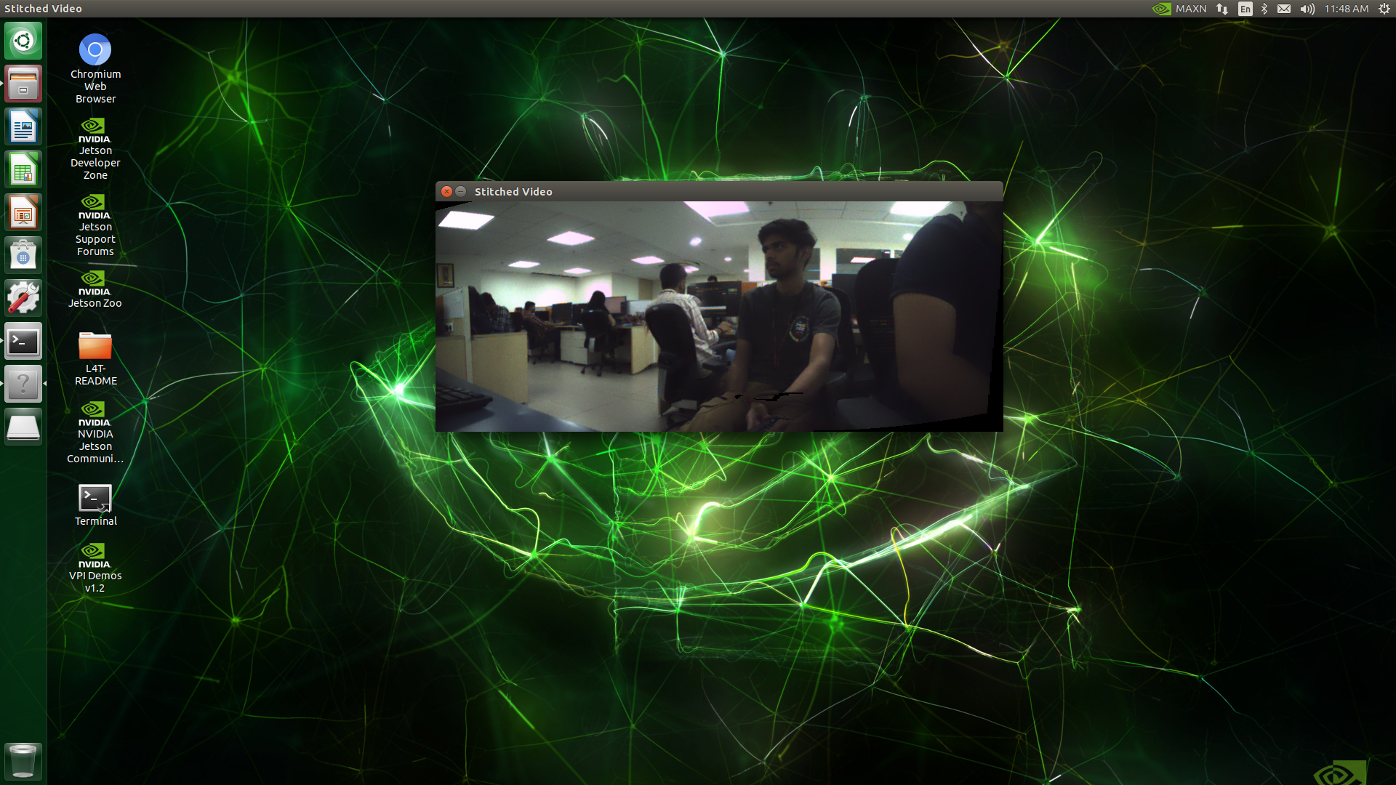
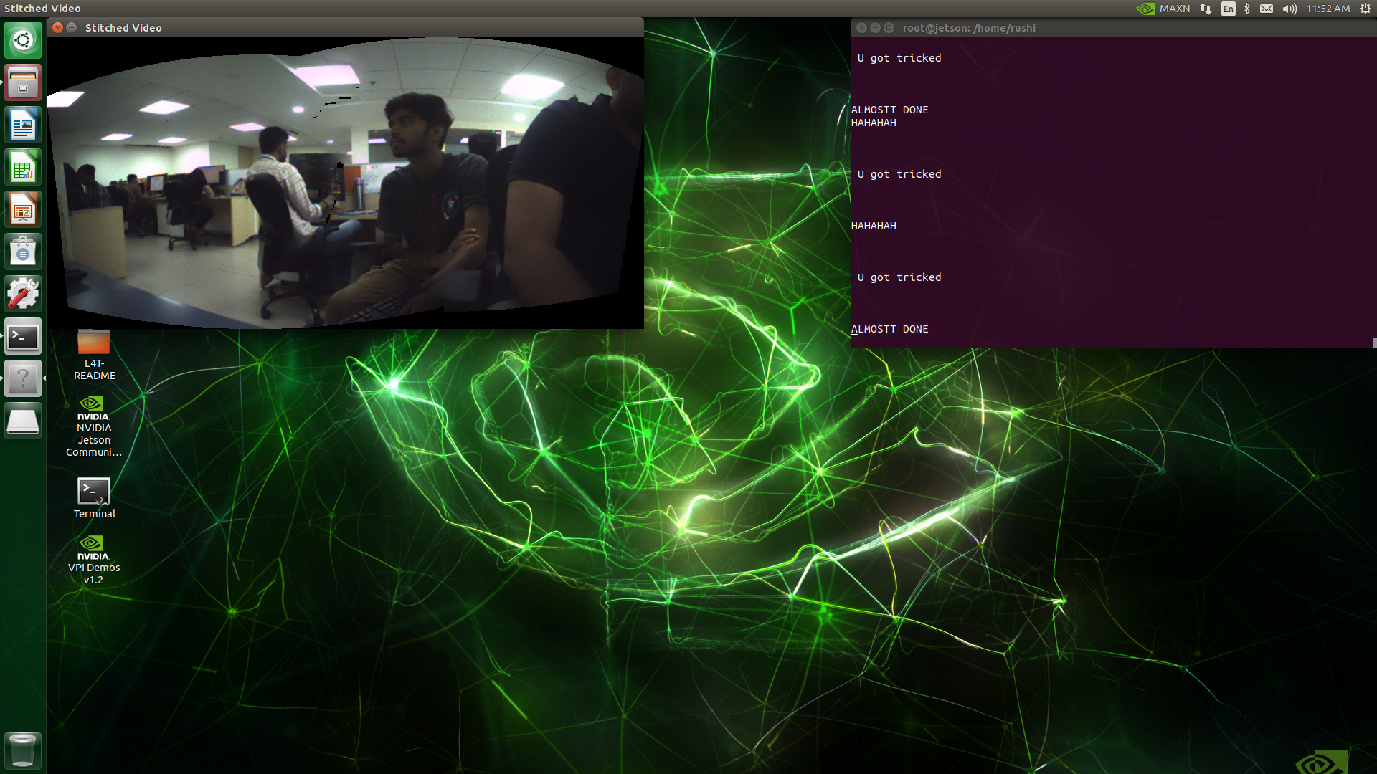
Results : Mipi cameras

Slide 13
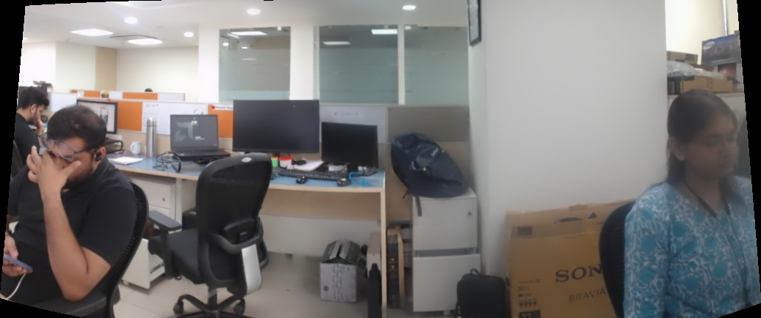
Results: USB cameras (logitech webcam)

Slide 14
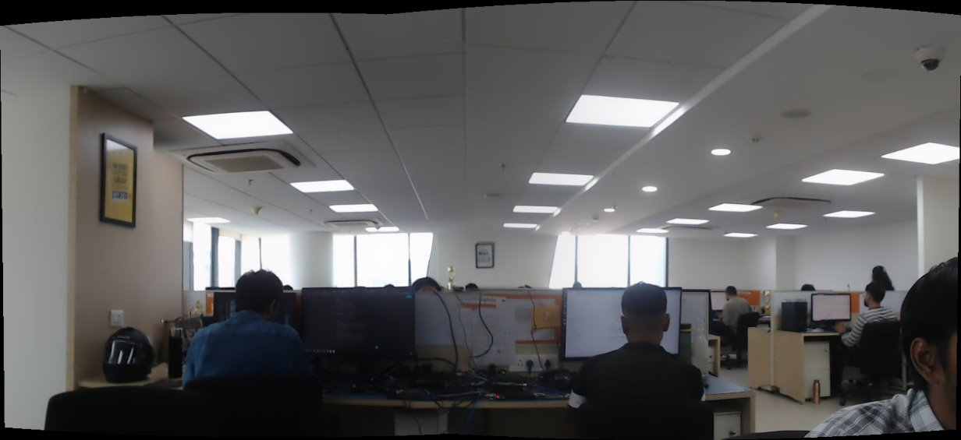
Results: USB cameras (logitech webcam)

